Slide 1
We trust in the Community!
Ravikanth chaganti

Slide 2
5
Video operator, did you start the recording?

Slide 3
4

Slide 4
3

Slide 5
2

Slide 6
1

Slide 7
We trust in the community!
Ravikanth Chaganti

Slide 8
In this session …
Learn about
different avenues that the PowerShell community provides
my favorite and most used PowerShell modules

Slide 9
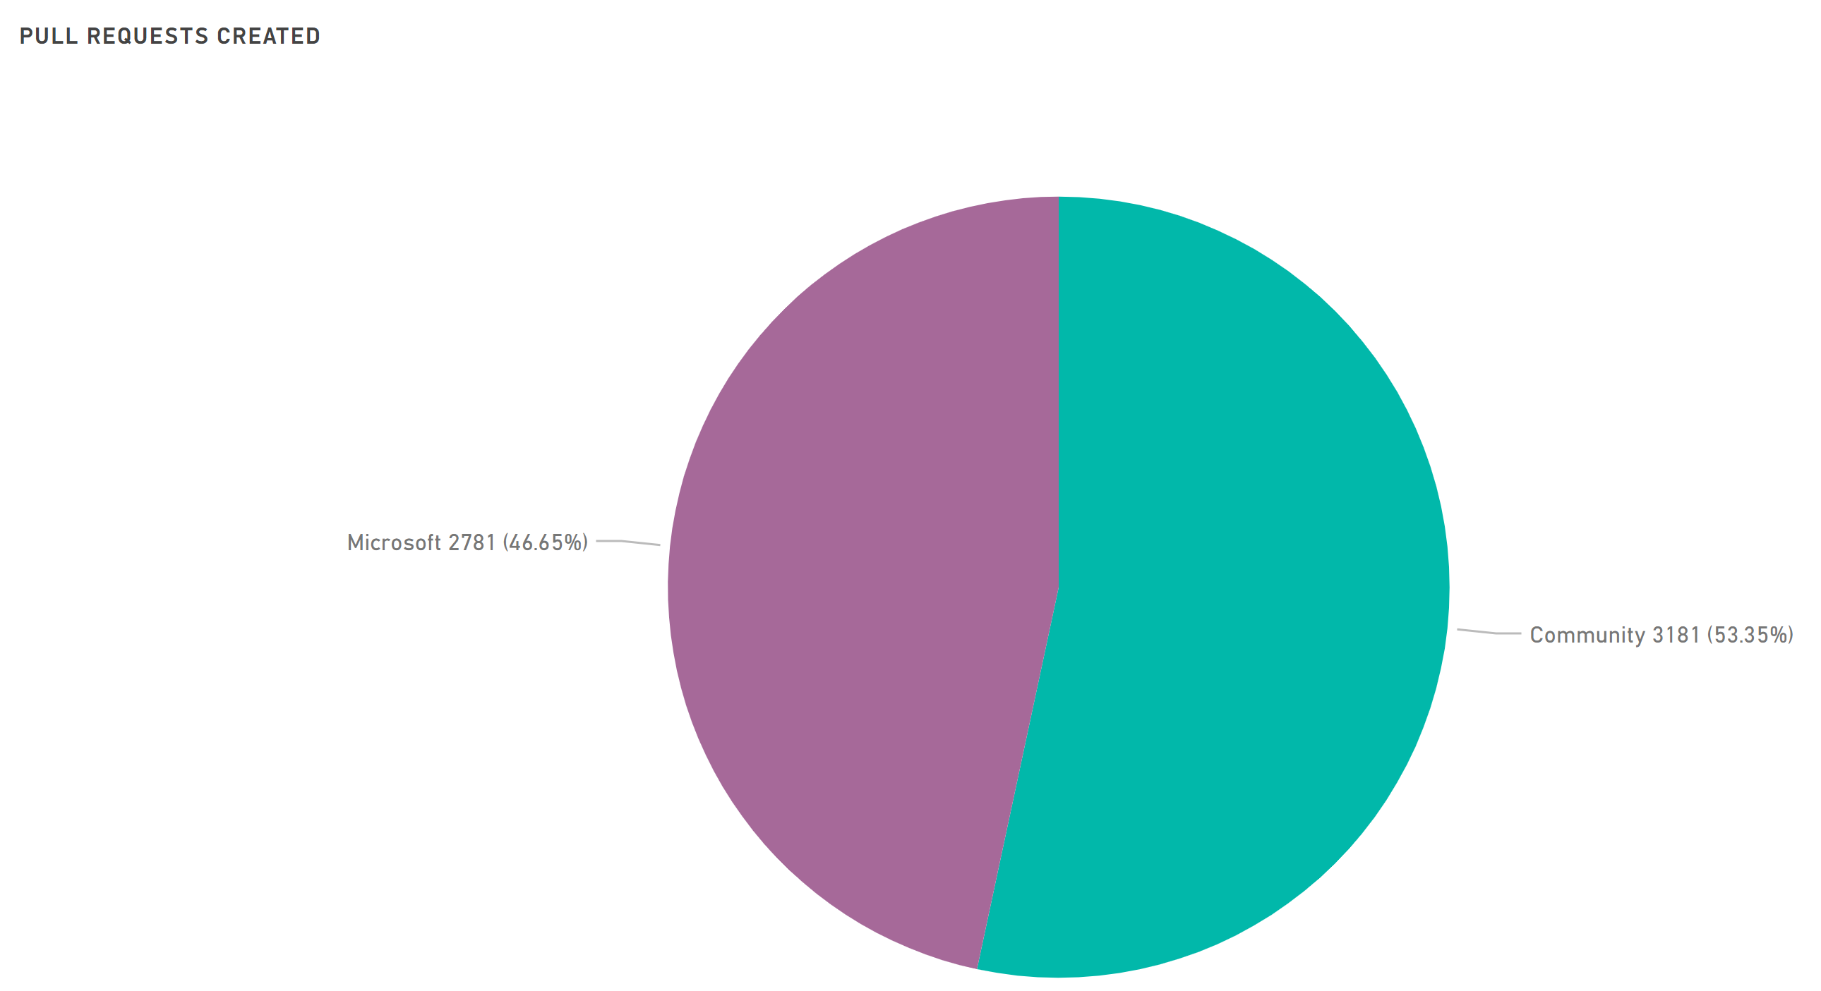
PowerShell Repository

Slide 10
Community Avenues
How the community helps you learn?

Slide 11
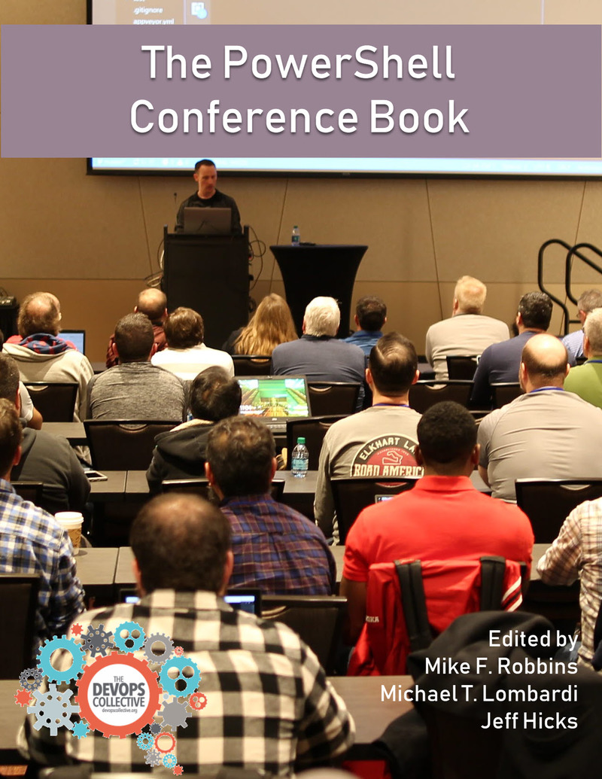
Community Avenues - Books

Slide 12




Community - Blogs

Slide 13





Community – Conferences / User groups

Slide 14
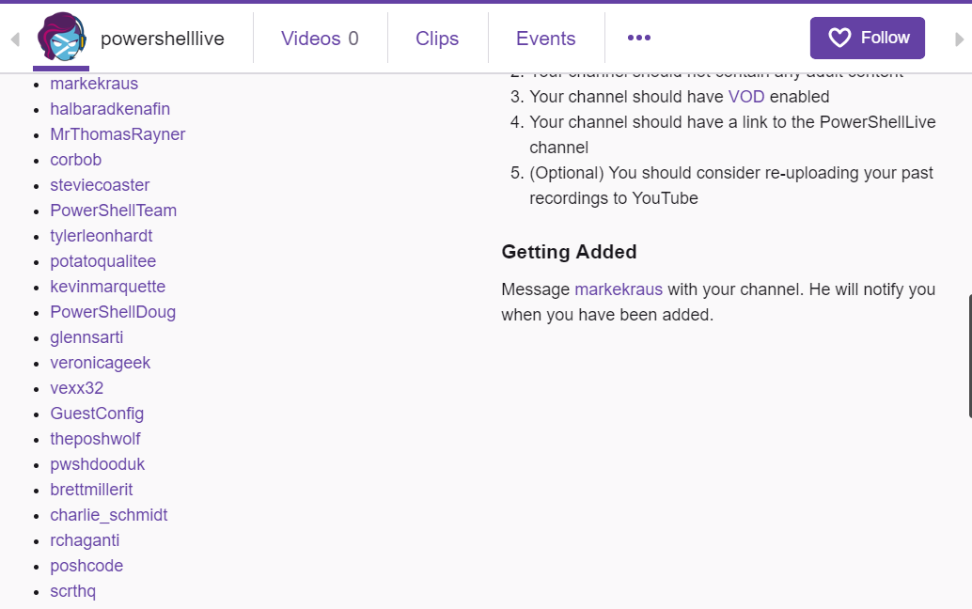
Community – Live Streaming
@PowerShellLive
twitch.tv/PowerShellLive

Slide 15


Community - Forums

Slide 16
Community Open Source Modules
4K+ modules in PowerShell Gallery
100s more may be in GitHub repositories!
Excellent support from community members
PESTER DBATOOLS PSHTML POLARIS IMPORTEXCEL PSGRAPH DSCRESOURCEKIT POSH-SSH UNIVERSALDASHBOARD POSHBOT PSAKE PSDEPLOY INVOKEBUILD

Slide 17
PSKoans
https://github.com/vexx32/PSKoans

Slide 18
ImportExcel

Slide 19
Polaris and PSHTML

Slide 20
PSGraph

Slide 21
Summary
The most powerful community
PowerShell Open Source Community Dashboard: http://aka.ms/PSGitHubBI

Slide 24
about_Speaker
Distinguished Member Technical Staff at Dell EMC
Multi-year Microsoft MVP (PowerShell)
Published Author
Founder and Editor of PowerShell Magazine
github.com/rchaganti
linkedin.com/in/rchaganti/

